Slide 1
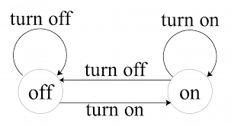
State Modeling

Slide 2
Introduction
The structure of objects and their relationships to each other in a system described by its static structure i.e. the class model.
Some objects in a system have complex temporal behaviors, which must be carefully design.
Temporal phenomena that occur over an interval of time are properly modeled with a state
The state model examine changes to the objects and their relationships over time
The state model describes the sequence of operations that occur in response to events (external stimuli)

Slide 3
Events
occurrence at a point in time
instantaneous
often corresponds to verb in past tense
e.g., alarm set, powered on
or onset of a condition
e.g., paper tray becomes empty, temperature drops below freezing
may logically precede or follow another or may be unrelated
e.g., Flight 123 must depart DDN before it can arrive in Delhi (causally related)
e.g., Flight 123 may depart before or after flight 345 departs DDN (causally unrelated)
Concurrent event: causally unrelated events; have no effect on one another

Slide 4
Kinds of events
Signal event:
the event of sending or receiving of a signal
Signal: an explicit one-way transmission of information from one object to another
may be parameterized
E.g., stringEntered(“Foo”)
sending of a signal by one object is a distinct event from its reception by another
Difference between signal and signal event
every signal transmission is a unique occurrence but we group them into signal classes to indicate common structure and behavior.
E.g., IA flight 123 departs from DDN on Jan 11, 2013 is an instance of FlightDeparture

Slide 5
Signal class - UML notation
keyword “signal” in << >>
<< signal >>
FlightDeparture
name of signal class
airline
flightNum
city
date
attributes

Slide 6
Kinds of Events
Change event
Event caused by satisfaction of a Boolean expression
Intent: Expression continually tested; when changes from false to true, the event happens
UML Notation: keyword when followed by parenthesized boolean expression
when(room temperature < heating set point)
when(room temperature > cooling set point)
when(battery power < lower limit)
when(tire pressure < minimum pressure)

Slide 7
Kinds of Events
Time event
Event caused by the occurrence of an absolute time or the elapse of a time interval
for absolute time the UML Notation: keyword when followed by parenthesized expression involving time
when (date = Jan 1, 2013)
for time interval the UML Notation: keyword after followed by parenthesized expression that evaluate to a time duration
after (n timeUnits)
after(10 seconds)

Slide 8
States
an abstraction of values and links of an object
behavioral condition that persists in time
according to gross behavior of objects, set of values and links are grouped together into a state
often corresponds to
verbs with suffix of “-ing”
e.g., Boiling, Waiting, Dialing
the duration of some condition
e.g., Powered, BelowFreezing
UML Notation: a rounded box containing an optional state name
Powered
Waiting
Dialing

Slide 9
Contd.
In defining states
ignore attributes that do not affect the behavior of the object
lump together in a single state all combinations of values and links with the same response to events
E.g., except for leading 0’s & 1’s, the exact digits dialed do not affect the control of the phone line, so we can define a state Dialing and track the phone number as a parameter
Objects in a class have a finite number of possible states
Each object can only be in one state at a time
At a given moment of time, the various objects for a class can exist in a multitude of states
A state specifies the response of an object to input events
E.g., if a digit is dialed in state DialTone, the phone line drops the dial tone and enters state Dialing;
If the receiver is replaced in state DialTone, the phone line goes dead and enters state Idle.

Slide 10
Symmetry between Events and States
Events represent points in time
State represent intervals of time. A state corresponds to the interval between two events received by an object
Power turned on
Power turned off
Power turned on
Powered
Not Powered

Slide 11
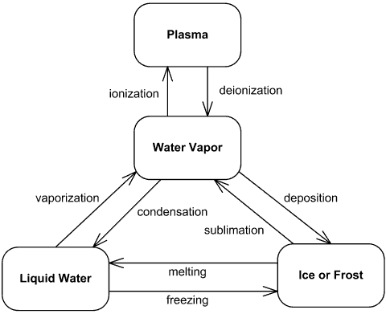

Slide 12
Transitions and Conditions
Transition: an instantaneous change in state
triggered by an event
Transition is said to fire upon the change from source to target state
Origin and target state of a transition are different states but may be the same
e.g., when a phone line is answered, the phone line transitions from the Ringing state to the Connected state.
Guard Condition:
boolean expression that must be true for transition to occur
checked only once, at the time event occurs; transition fires if true
E.g., when you go out in the morning (event), if the temperature is below freezing (condition), then put on your gloves (next state).

Slide 13
Enabling and firing of transitions
Transition is:
enabled when source state is active and guard condition satisfied
fires when enabled and the triggering event occurs
Example below:
enabled when current state is Editing and the form is complete
fires when the user presses the “OK” button
pressOK [form complete]
Editing
Submitted

Slide 14
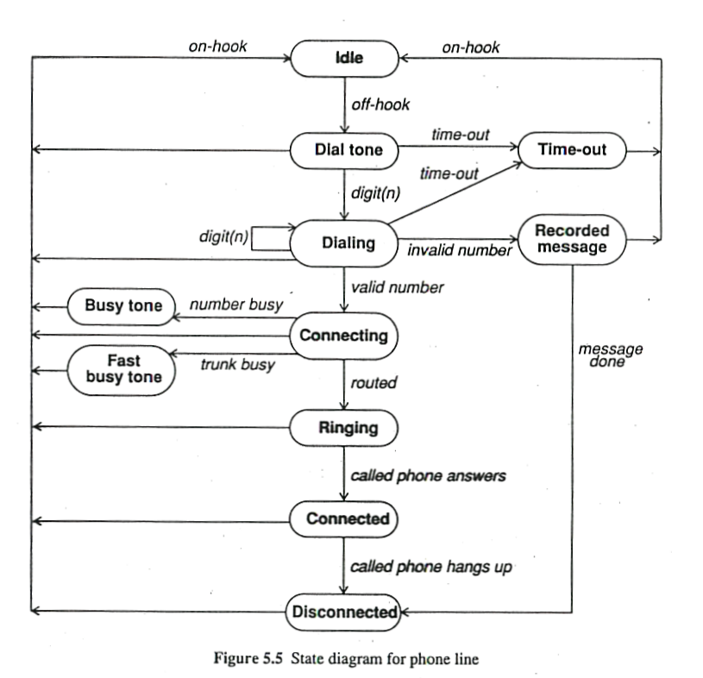
Phone Line example

Slide 15
State Diagrams
a graph whose nodes are states and whose directed arcs are transitions between states
specifies state sequences caused by event sequences
all objects in a class execute the state diagram for that class; diagram models their common behavior
Note: state names are unique within the scope of state diagram
A class with more than one state has important temporal behavior
A class is temporarily important if it has a single state with multiple responses to events

Slide 16
State diagrams
Graphical state-modeling notation:
States: labeled rounded box
Transitions: directed arcs, labeled by triggering event, optional guard condition, and/or effects
Specifies the response of an object to input events
- ignores events except those for which behavior is prescribed
Example:
S
T
States

Slide 17
State diagrams
Graphical state-modeling notation:
States: labeled rounded box
Transitions: directed arcs, labeled by triggering event, optional guard condition, and/or effects
Specifies the response of an object to input events
- ignores events except those for which behavior is prescribed
Example:
Transition
S
T
States

Slide 18
State diagrams
Graphical state-modeling notation:
States: labeled rounded box
Transitions: directed arcs, labeled by triggering event, optional guard condition, and/or effects
Example:
Transition
Event
event(attribs) [condition] / effect
S
T
States

Slide 19
State Model
multiple state diagrams, one for each class with important temporal behavior
events and guard conditions must match across diagrams in the model
if more than one transition leaves a state, then the first event to occur causes the corresponding transition to fire
if an event occurs and no transition matches it, the event is ignored
if more than one transition matches an event, only one transition will fire but the choice is non-deterministic

Slide 20
State diagrams can represent
Continuous loops
Do not care, how the loop is started
One-shot life cycles

Slide 21
“One-shot” state diagrams
represent objects with finite lives
have initial and finite states
initial state - entered on object creation
final state - entry implies destruction of object

Slide 22
Example
Chess game
start state
White’s
turn
checkmate
black
moves
white
moves
stalemate
stalemate
Black’s
turn
checkmate
Default final state

Slide 23
Example
Chess game
Black
wins
start state
checkmate
White’s
turn
stalemate
Final
states
black
moves
white
moves
Draw
Black’s
turn
stalemate
White
wins
checkmate

Slide 24
Example - entry and exit points
Chess game
checkmate
White’s
turn
Black wins
Draw
White wins
stalemate
black
moves
white
moves
stalemate
Black’s
turn
checkmate

Slide 25
Activity Effects
SD would be of little use if they just describe events
What object does in response to events
effect = reference to a behavior executed in response to an event
can be attached to a transition or a state
listed after a slash (“/”)
multiple effects separated with a “,” and are performed concurrently

Slide 26
Activity Effects
Activity = actual behavior that can be invoked by any number of effects
E.g.: disconnectPhoneLine might be an activity executed in response to onHook event
May be performed upon:
a transition
entry to or exit from a state
some event within a state
Notation:
event / resulting-activity
Activities can also represent internal control operations.
E.g. setting attribute or generate other events

Slide 27
Activities
Often useful to specify an activity that is performed within a given state
E.g., while in PaperJam state, the warning light should be flashing
E.g., on entry into the Opening state, the motor should be switched on
E.g., upon exit of the Opening state, the motor should be switched off

Slide 28
Activity effects
Cursor moved / highlight menu item
r_button_push / showPopup
Idle
Menu visible
l_button_push / hidePopup

Slide 29
Do-Activities
continue for an extended time
can occur only within a state & can not be attached to a transition
include
continuous operations, such as displaying a picture on a television screen
Sequential operations that terminate by themselves after an interval of time
may be performed for all or part of time that an object is in a state
may be interrupted by event received during execution; event may or may not cause state transition
A robot moving a part may encounter resistance, causing it to cease moving
PaperJam
do/ flash warning light

Slide 30
Entry and Exit Activities
can bind activities to entry to/ exit from a state
All transitions into a state perform the same activity, in which case it is more concise to attach the activity to the state
Opening
entry / motor up
exit / motor off

Slide 31
Order of activities
activities on incoming transition
entry activities
do-activities
exit activities
activities on outgoing transition
Events that cause transitions out of the state can interrupt do-activities. If a do-activity is interrupted, the exit activity is still performed

Slide 32
In general, any event can occur within a state and cause an activity to be performed.
Entry and exit are only two examples of events that can occur
Difference between an event within a state and self-transition: only the self-transition causes the entry and exit activities to be executed but an event within a state does not

Slide 33
Completion Transition
triggered by completion of activity in the source state
Often the sole purpose of a state is to perform a sequential activity.
When the activity is completed, a transition to another state fires
An arrow without an event name indicates an automatic transition that fires
State 1
do / blah()
State 2

Slide 34
Contd.
If a state has one or more completion transitions, but none of the guard conditions are satisfied, then the state remains active and may become ‘stuck’.
The completion event does not occur a second time
Therefore no completion transition will fire later to change the state
So if a state has completion transition leaving it, normally guard condition should cover every possible outcome.
Do not use guard condition on a completion transition to model waiting for a change of value

Slide 35
Sending signals
A object can perform the activity of sending a signal to another object.
A system of objects interact by exchanging signals
The activity “send target.S(attributes)” sends a signal S with the given attributes to the target object.
E.g., the phone line sends a connect(phone number) signal to the switcher when a complete phone number has been dialed.
A signal can be directed to a set of objects or a single object.
If the target is a set of objects, each of them receives a separate copy of the signal concurrently and independently process the signal and determines whether to fire a transition or not
If an object receive signals from more than one object, the order in which concurrent signals are received may affect the final state (race condition)

Slide 36
Advanced state modeling
Conventional state diagrams are sufficient for describing simple systems but need additional power to handle large problems
Model complex system by using
Nested state diagrams
Nested states
Signal generalization
Concurrency

Slide 37
Nested state diagram
Expanding state
Organize the model by having high-level diagram with sub diagrams expanding certain states
Submachine: a state diagram that may be invoked as part of another state diagram (lower-level state diagram).
UML Notation for submachine: list a local name followed by a colon and the submachine name.

Slide 38
Nested state
Nest states to show their commonality and share behavior
Composite state: state that encloses the nested states.
Labels in the outer contour
A nested state receives the outgoing transitions of its composite states

Slide 39
Example: Transmission
Transmission
push R
Reverse
Neutral
push N
push N
push F
Forward
downshift
downshift
1st
2nd
3rd
upshift
upshift
stop

Slide 40
Signal Generalization
Organize signals into generalization hierarchy with inheritance of signal attributes
View every actual signal as a leaf on a generalization tree of signals.
Received signal triggers transitions that are defined for any ancestor signal type.
E.g., typing an ‘a’ would trigger a transition on signal Alphanumeric as well as signal KeyboardCharacter.
A signal hierarchy permits different levels of abstraction to be used in a model.
E.g., some state might handle all i/p characters the same; other states might treat control characters differently from printing characters .

Slide 41
CONCURRENCY
State model supports concurrency among objects
Object can act & change state independent of one another.
Sometime objects shares constraints that causes their state changes

Slide 42
AGGREGATION CONCURRENCY
State Aggregation means collection of state diagrams , one for each part
“and” relationship
Aggregate state is one state from first diagram & a state from second diagram & state from each other diagram.
Transition for one object depend on another object, allows interaction between the state diagram.

Slide 43
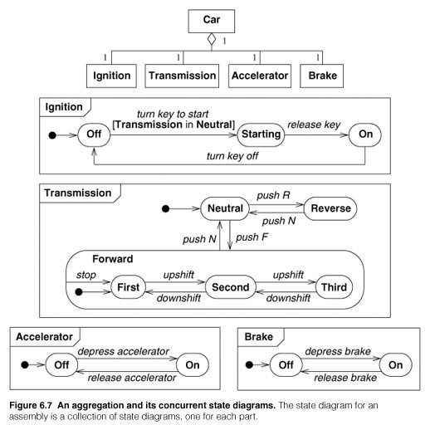

Slide 44
Concurrency within an Object
Some objects can be partitioned into subsets of attributes or links.
Each of the partitioned subset has its own subdiagram.
The state of the object comprises one state from each subdiagram.
The sub diagrams need not be independent; the same event can cause transitions in more than one subdiagram
UML Notation- partition the composite state into regions with dotted lines.

Slide 45
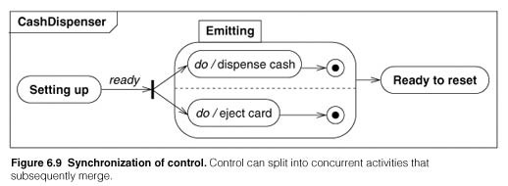
Synchronization of Concurrent Activities
Sometimes one object must perform two ( or more) activities concurrently.
The object must complete both activities before it can progress to its next state.

Slide 46
Fork and Join OR Splitting control and Merging control
FORK- A transition that forks indicates splitting of control into concurrent parts.
JOIN- Explicit merging of concurrent control by a transition.

Slide 47
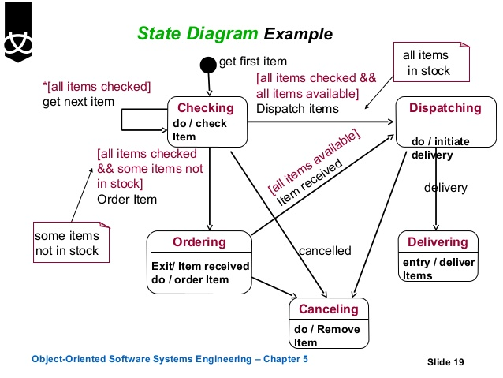

Slide 48
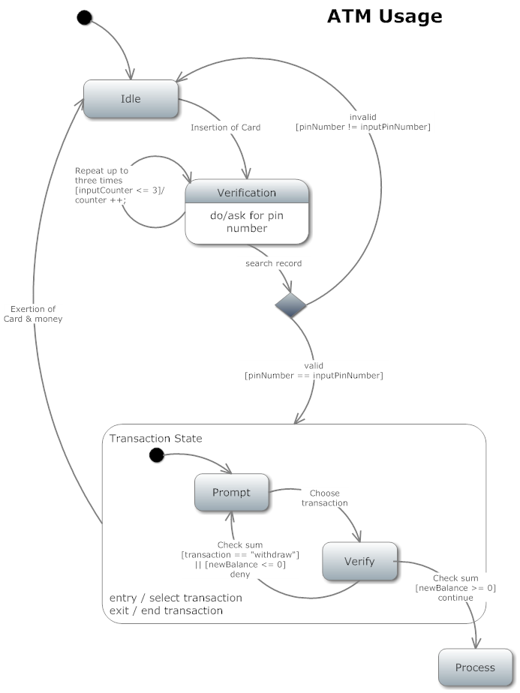

Slide 49
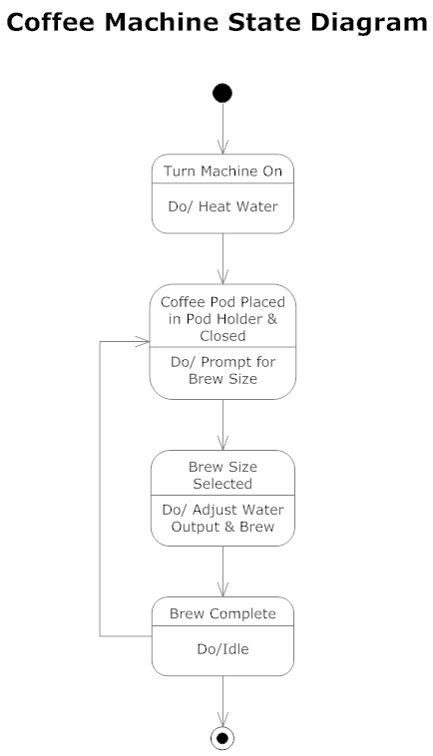

Slide 50
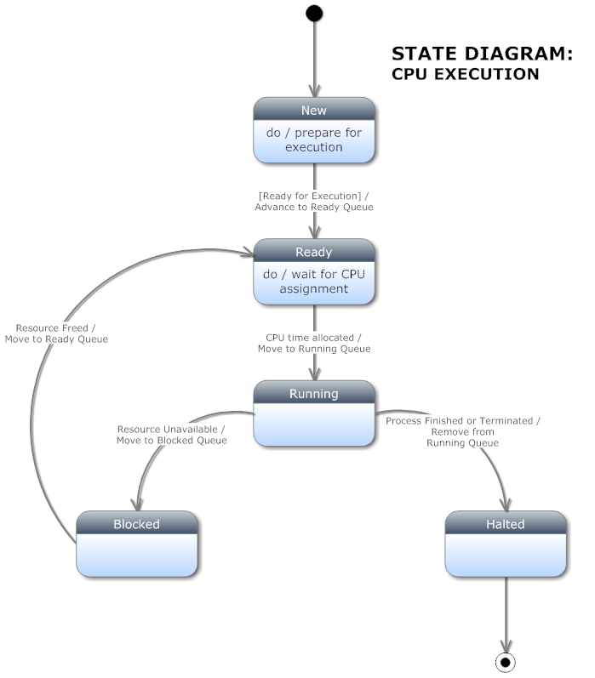

Slide 51
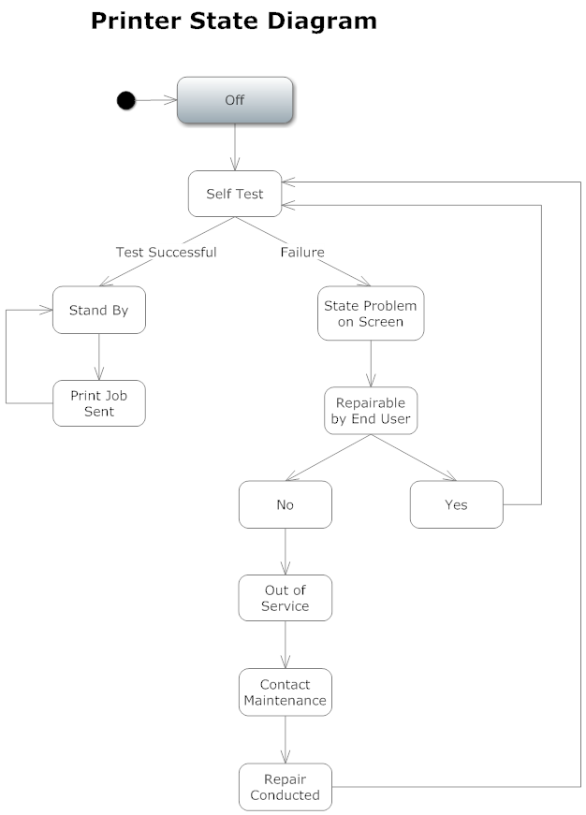

Slide 52
